Slide 1

INTER-AMERICAN
DEVELOPMENT BANK
PPPs and Public Procurement
Fiscal and Municipal Division (IFD/FMM)

Slide 2
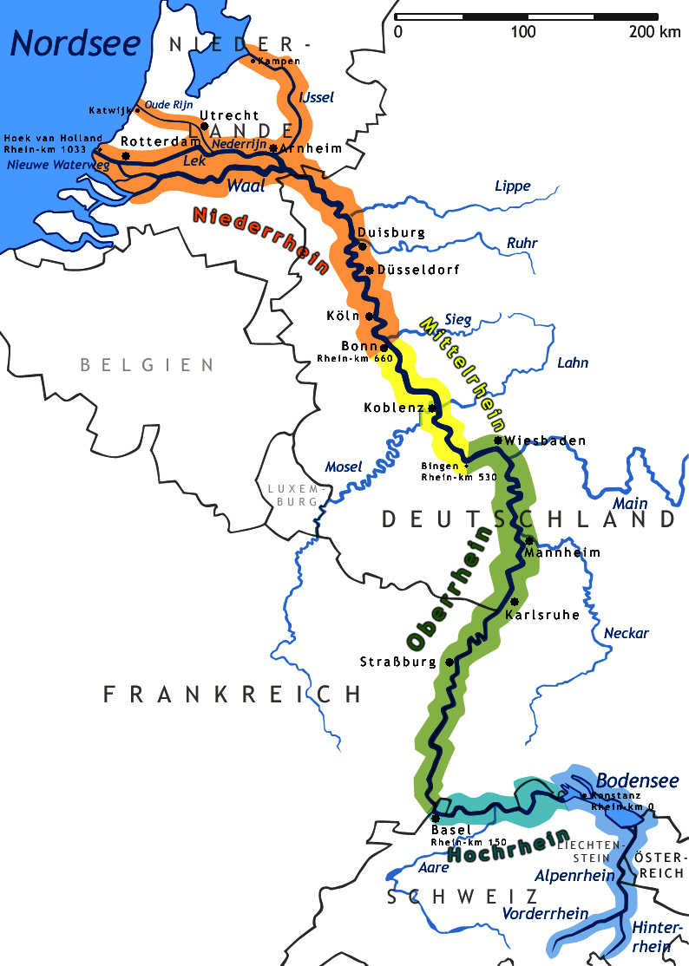
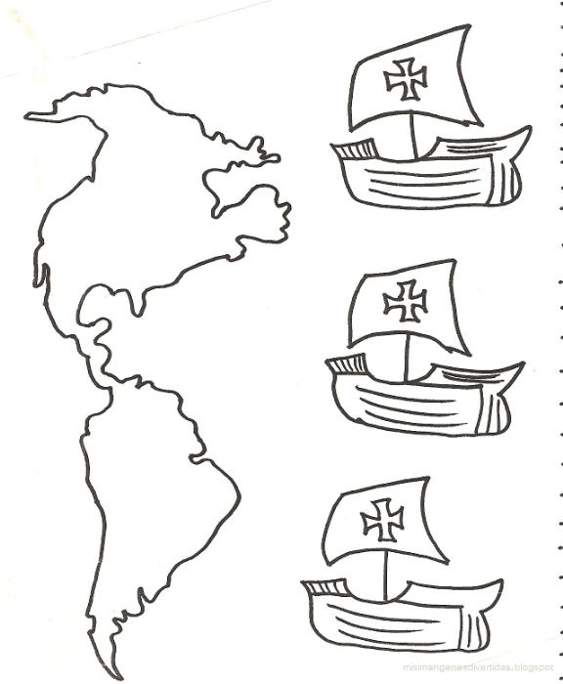

What do they have in common?
1.438
1.492
1.792

Slide 3
The Reality of the PPPs
PPPs are by no means a new concept.
PPPs is a concept too broad to limit it to concessions.
In recent times and probably in the future, PPPs will be essential in large projects given the constraints of public funding and limits on deficits.
In other projects, where research and innovation are essential for the provision of public services, the experience of the private sector can also be vital.
Each new project is a blank page that the public and the private sector have to fill with the objectives and resources that each one can and want to contribute.

Slide 4

What is a PPP?

Slide 5
PPP Meaning
The word partnership comes from the latin word "Societas" (gen "societatis”)- “Association, union”-; of "socius” - "ally, friend”-; and the verb "sequor" - "continue, accompany".
“PPPs refer to a wide range of contractual arrangements between the public and private sectors, not only financing, where both parties share skills and resources to provide, goods or services of traditional public domain for use by the general public. Besides the exchange of knowledge and resources, a crucial element of these agreements is that each participant shares the risks and benefits of projects. The public sector could include governments, at every level, and agencies, and even international financial institutions such as the IDB, the World Bank, the IFC and the Asian Development Bank. The private sector could also include non-profit organizations (NGOs and civil society).”

Slide 6
PPPs vs. Public Procurement
PPPs
Public Procurement
It focuses on results and link quality to payments.
It's a partnership.
Distribution of Risks
Both sectors contribute in the design phase
It focuses more on products and inputs.
It is a buyer-supplier contract.
The Government assumes all the risks.
The government assumes the design

Slide 7
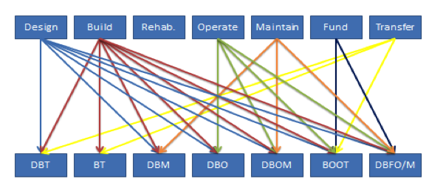
Models and Activities
Source: Enrique Moreno de Acevedo Sánchez

Slide 8
Public/Private Participation in PPPS
Service Contract
(Framework Agrement)
Divestiture
Public
Private
DBM, DBO, DBOM, BOOT, BOO, DBFO, …..
Public Procurement
PPP
Source: Enrique Moreno de Acevedo Sánchez

Slide 9
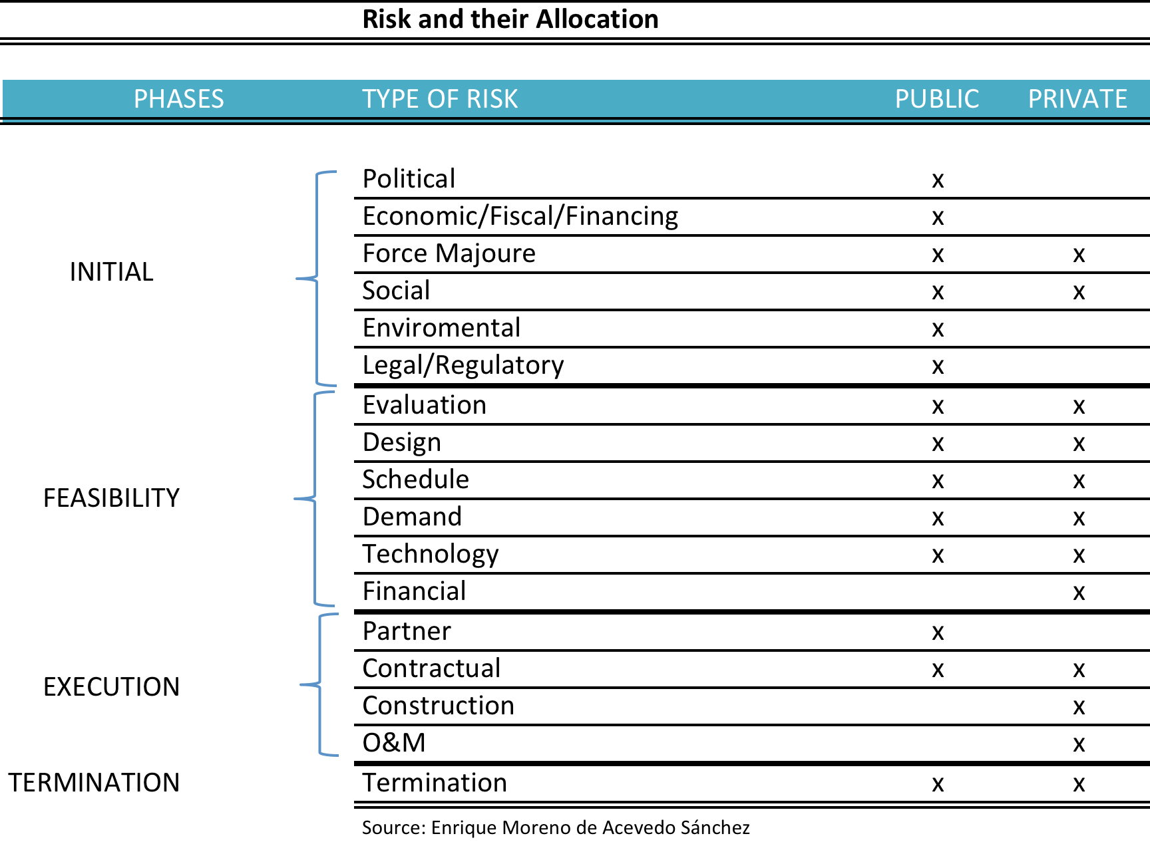
Risks and Distribution

Slide 10
PPP Process
Needs and Project Assesment
Awareness
Demand Study
Financial and Economic Study
Technical Study
Structuring
Bidding and
Negotiation
Process
Construction
O&M
Maturity
Transfer
New PPP
Pre
Feasibility Study
Execution
Post
1
2
3
4
5
6
Source: Enrique Moreno de Acevedo Sánchez

Slide 11
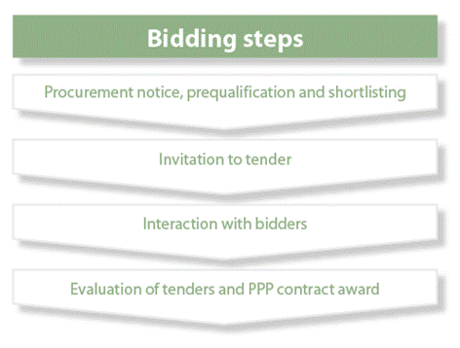
Tender (I)
The tender should bring the
potential participants to a
competitive process under the
same rules, to select the best
partner at the best price.
Concurrence
Equal treatment
Transparency
Advertising

Slide 12
Tender (II)
Financial arrangements:
Senior and subordinated debt
Common terms
Shareholders
With financers
(step-in clauses)
Accounts (screw account)
Hedge (forex)
Holding guarantees
Consortium members
guarantees (Solidarity)

Slide 13
Advantages
Combined services in a single contract and a single private entity or consortium.
Clear levels of accountability and transparency.
Financing according to the project.
Risk and capacity sharing.
VFM (LSE / Arthur Andersen (2000) Partnership Victoria (2004), Sachs (2005)
On time and less cost overruns (Mott MacDonald (2002), HM Treasury (2003), Thomson (2005 for the EIB)).

Slide 14
Precautions
More complicated structuring requires appropriate institutional capacity and experience (PPP Unit).
Higher transaction costs
Hidden debt and not accounting for contingencies
Renegotiations
Optimistic projections.
Risk sharing according to the capacities to manage and minimize them
Appropriate contractual and competitive process structure.
Excessive returns
Technological innovation (Glasgow Schools PFI Project and ICT)
Small projects?

Slide 15
New PPP Models
Bundling: A single private partner, several PPPs
Competitive Partnership
Incremental Partnership
Integrator
Joint Venture

Slide 16

THANK YOU!
Enrique Moreno de Acevedo Sánchez
emoreno@iadb.org

